Slide 1
Functional Data that Changes and Adapts ….for High Performance Functional UIs
Don Syme @dsyme
With material from Thomas Ortner @thomasortner, Georg Haaser @krauthaufen, Harald Steinlechner @haraldsteinlechner + Aardvark contributors

Slide 2
Situation

Slide 3
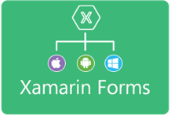







Situation: The world of UI is developing
OO programming
Mutable models
View in 2nd markup language
Functional programming
Immutable models
View in same language DSL
MVVM
(model-view-viewmodel)
MVU
(model-view-update)

Slide 4
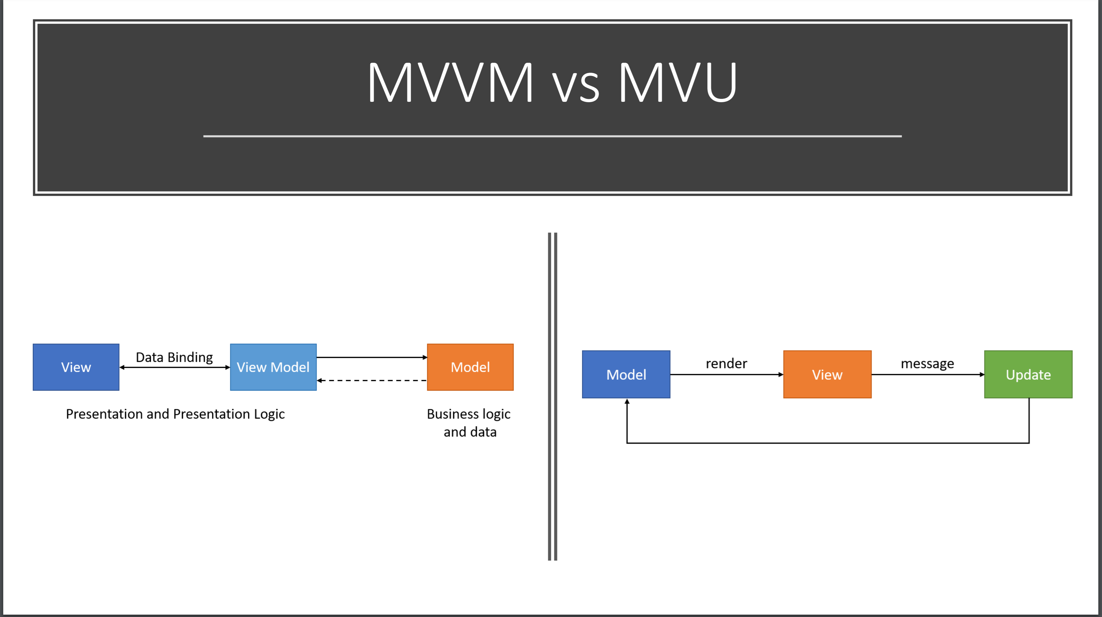

Slide 5
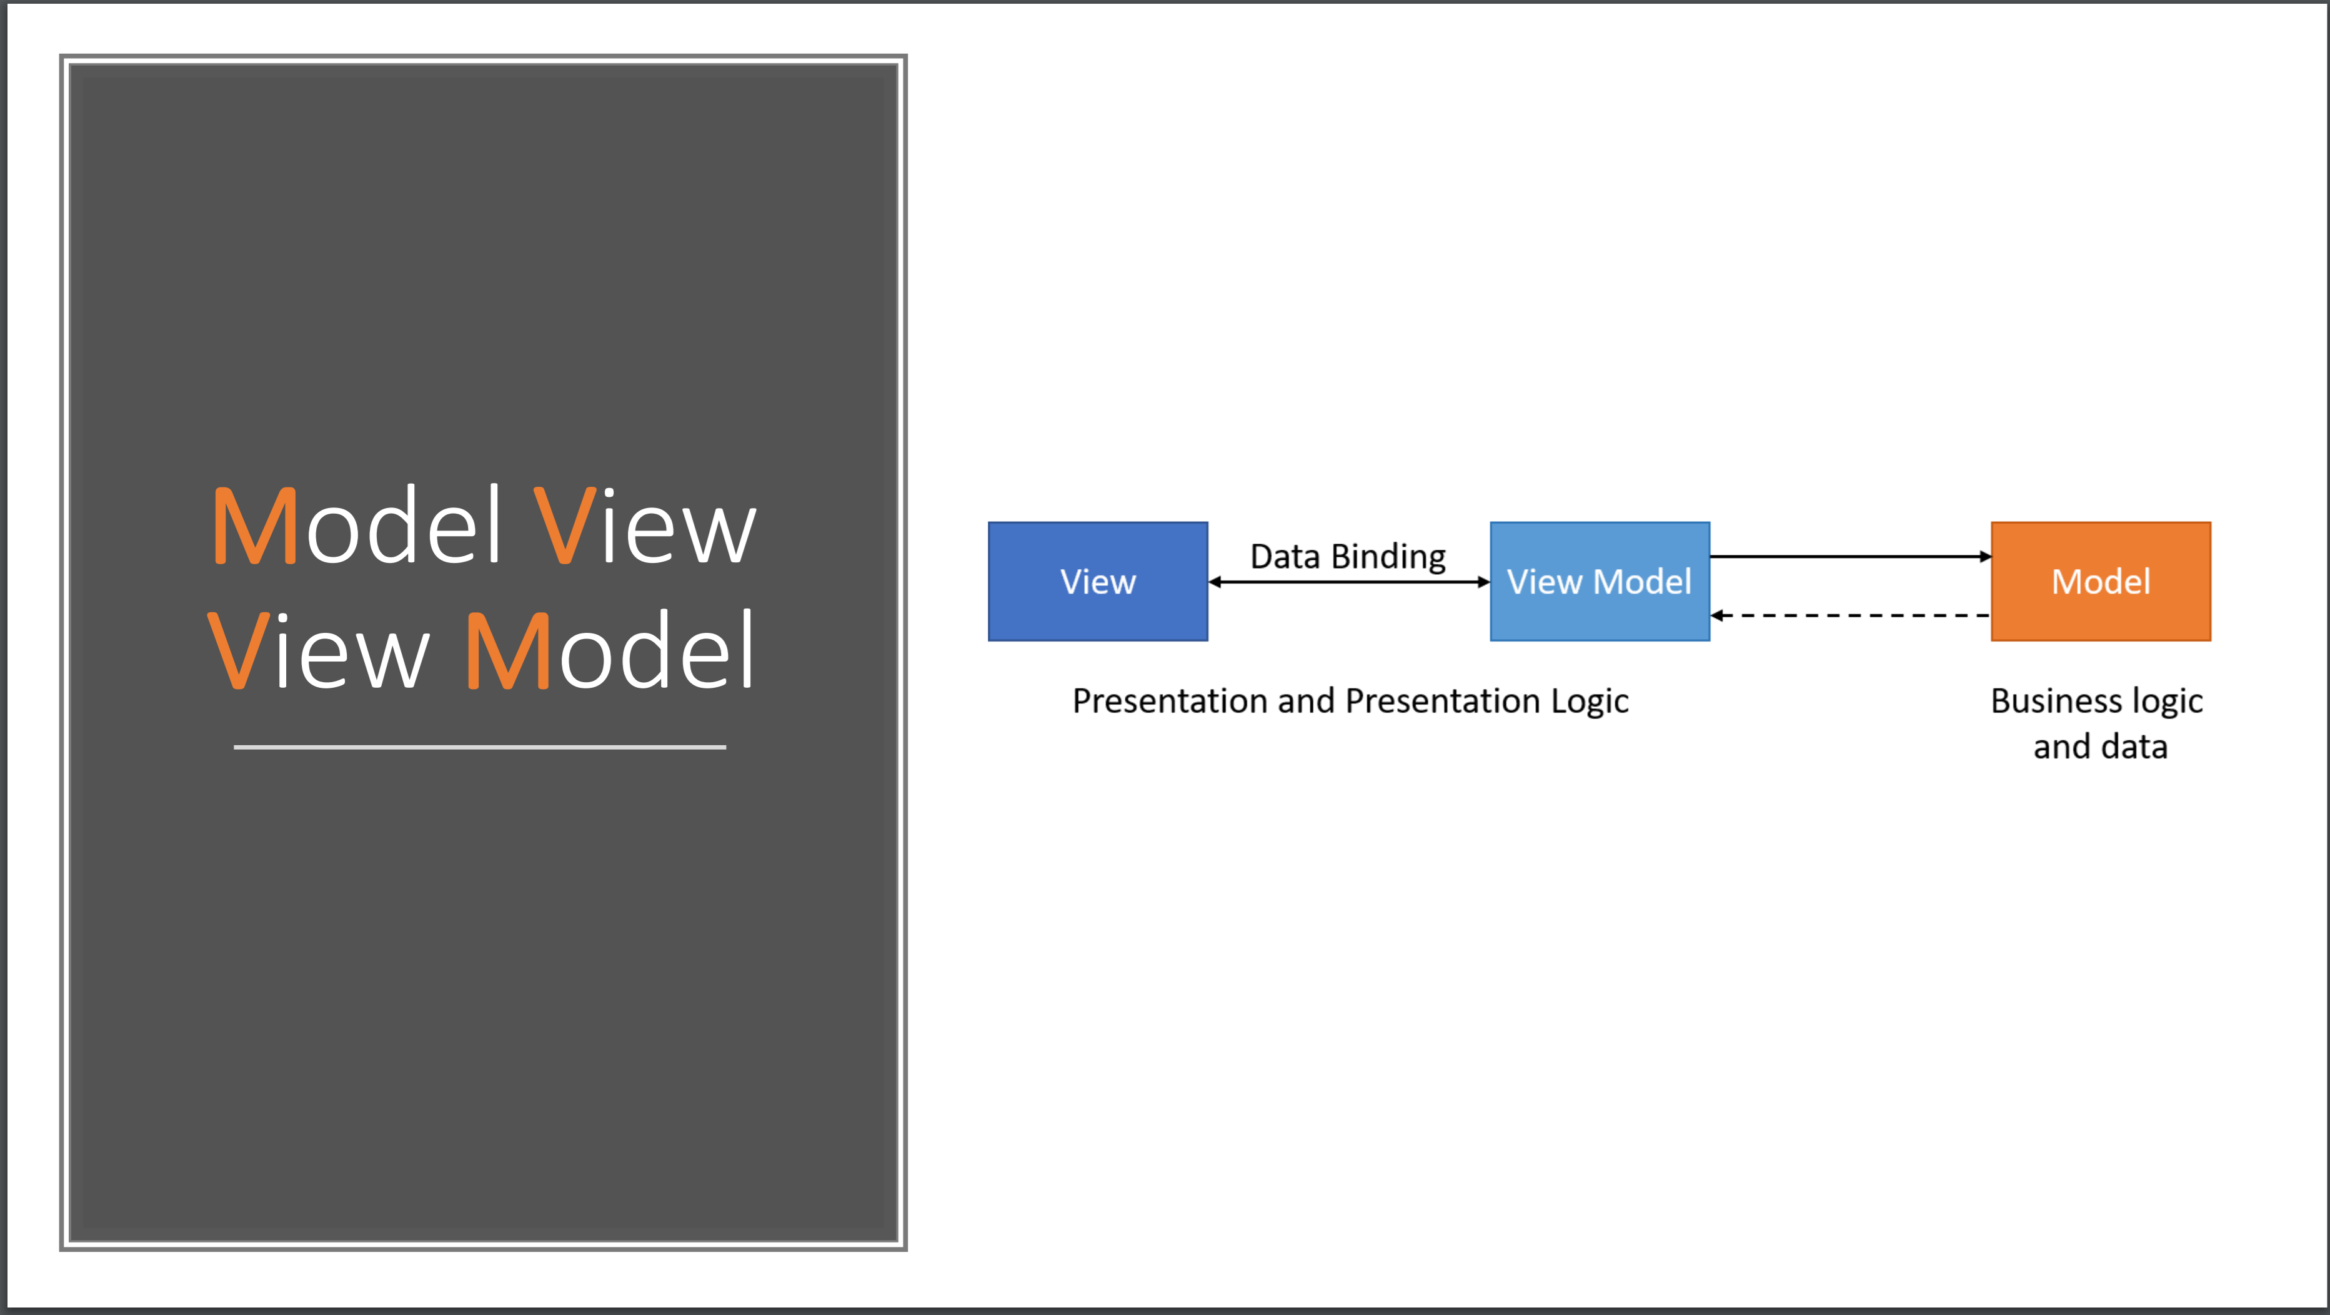

Slide 6
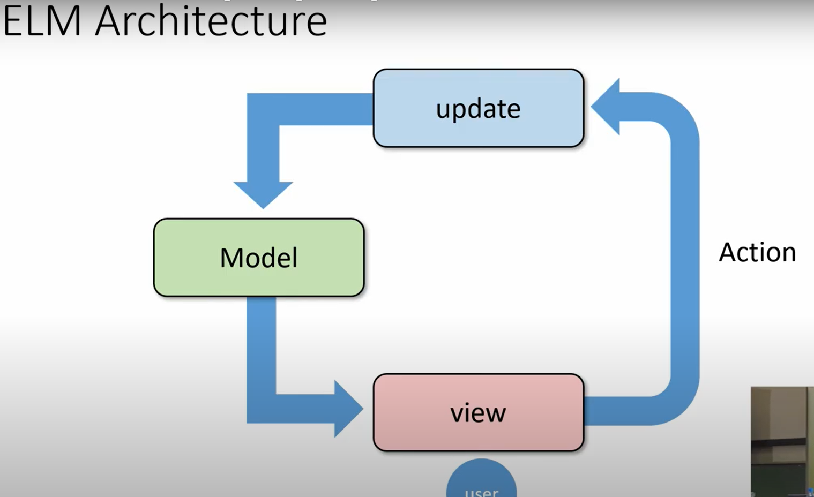


Slide 7



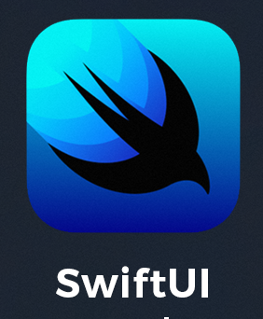


MVU and its variations are becoming ubiquitous
MAUI

Slide 8
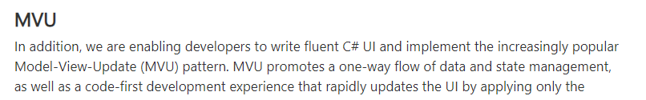
The ideas I talked about last year at NDC…
Are now strongly contributing to the future of .NET UI…..

Slide 9
But can we go further? Is Functional relevant to high performance UI?

Slide 10


Slide 11
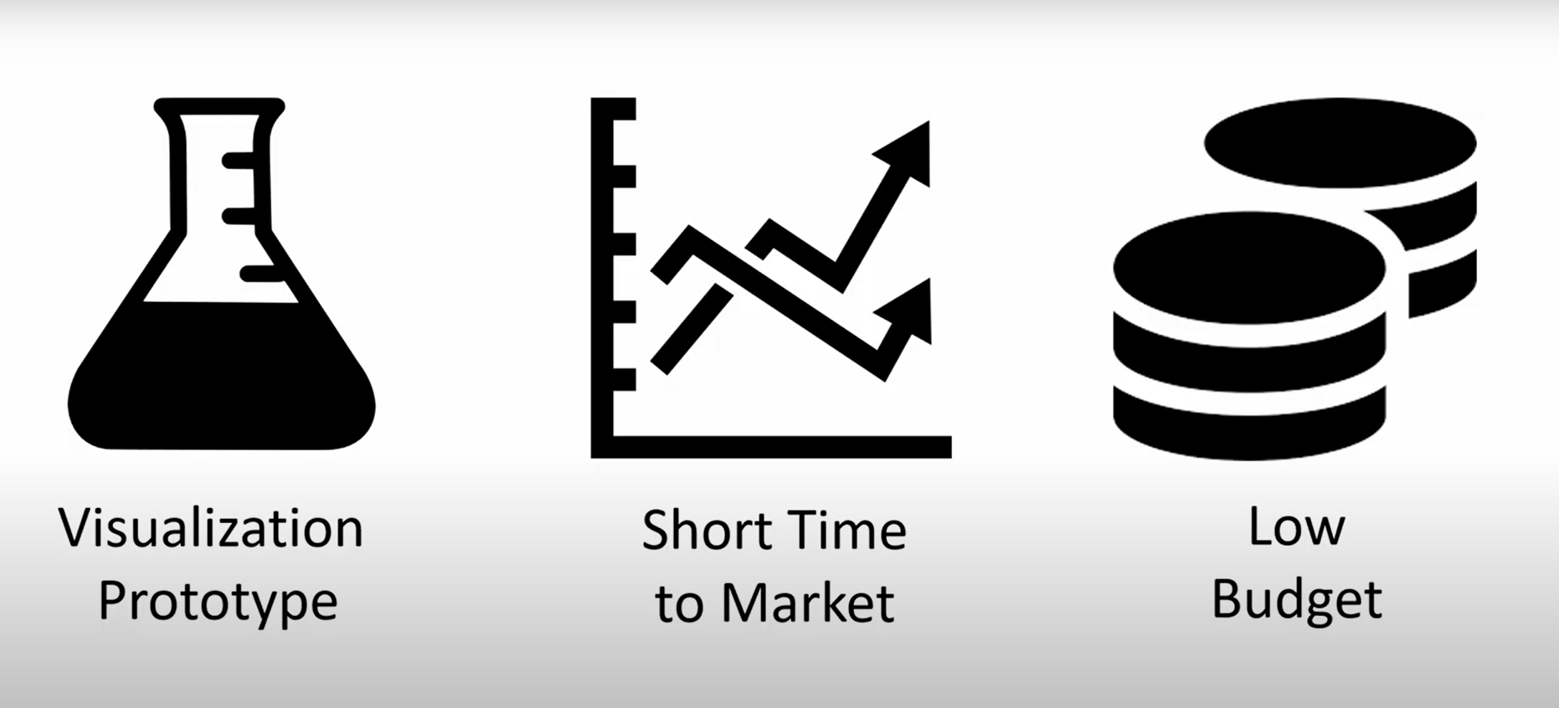

Slide 12

https://www.youtube.com/watch?v=sVM8inY9YWo

Slide 13
Let’s get Back to Basics

Slide 14
A Simple MVU App
type Model =
{ … }
type Msg =
| …
| …
let init() =
{ … }
let update msg model =
match msg with
| … -> { model with … }
| … -> { model with … }
let view model dispatch =
if … then
… label … (fun () -> dispatch msg) …
else
… button … (fun () -> dispatch ) …
The model from which
the view is generated
Messages which cause
updates to the model
Initial state
Update the model
Compute the view

Slide 15
A Simple MVU App
type Model =
{ IsPressed: bool }
type Msg =
| Pressed
let init() =
{ IsPressed=false }
let update (msg: Msg) (model: Model) =
match msg with
| Pressed -> { model with IsPressed = true }
let view (model: Model) dispatch =
if model.IsPressed then
View.Label(text="I was pressed!")
else
View.Button(text="Press Me!", command=(fun () -> dispatch Pressed))
The model from which
the view is generated
Messages which cause
updates to the model
Initial state
Update the model
Compute the view

Slide 16
It’s all just functional programming!
UI becomes calculation and information, not state…
Views are re-computed and differentially applied

Slide 17

Functional for rapid update, data-intense, interactive UI?

Slide 18

Incremental functional for rapid update, data-intense, incremental interactive UI?

Slide 19
Incremental + Functional? What even is that?

Slide 20
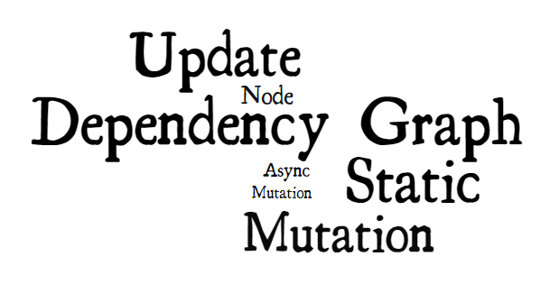
Incremental makes me think…

Slide 21
A secret…. Incrementality is likely the major source of mutable objects and “static thinking” in your team
If you master incremental functional, you will be able to do more functional everywhere

Slide 22
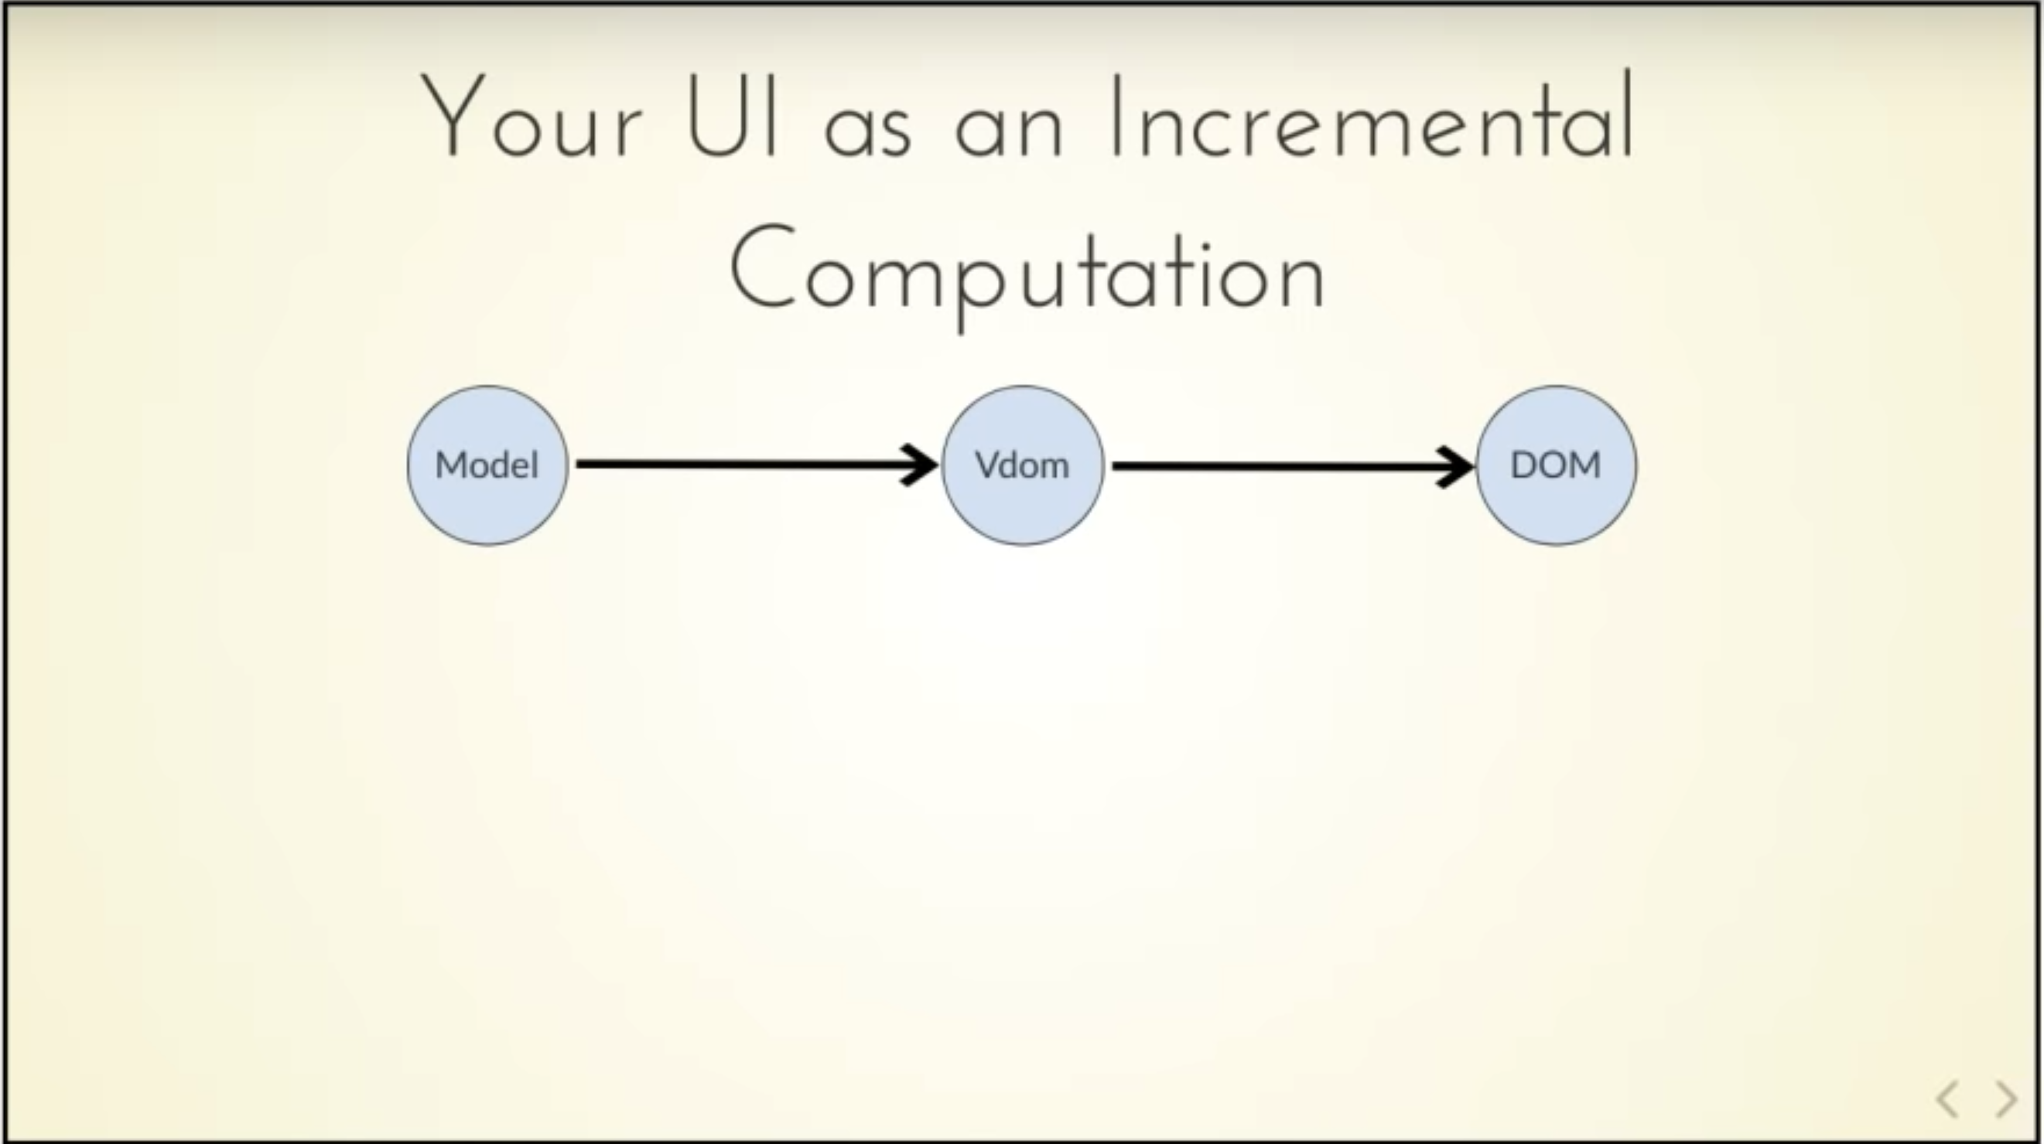


Slide 23
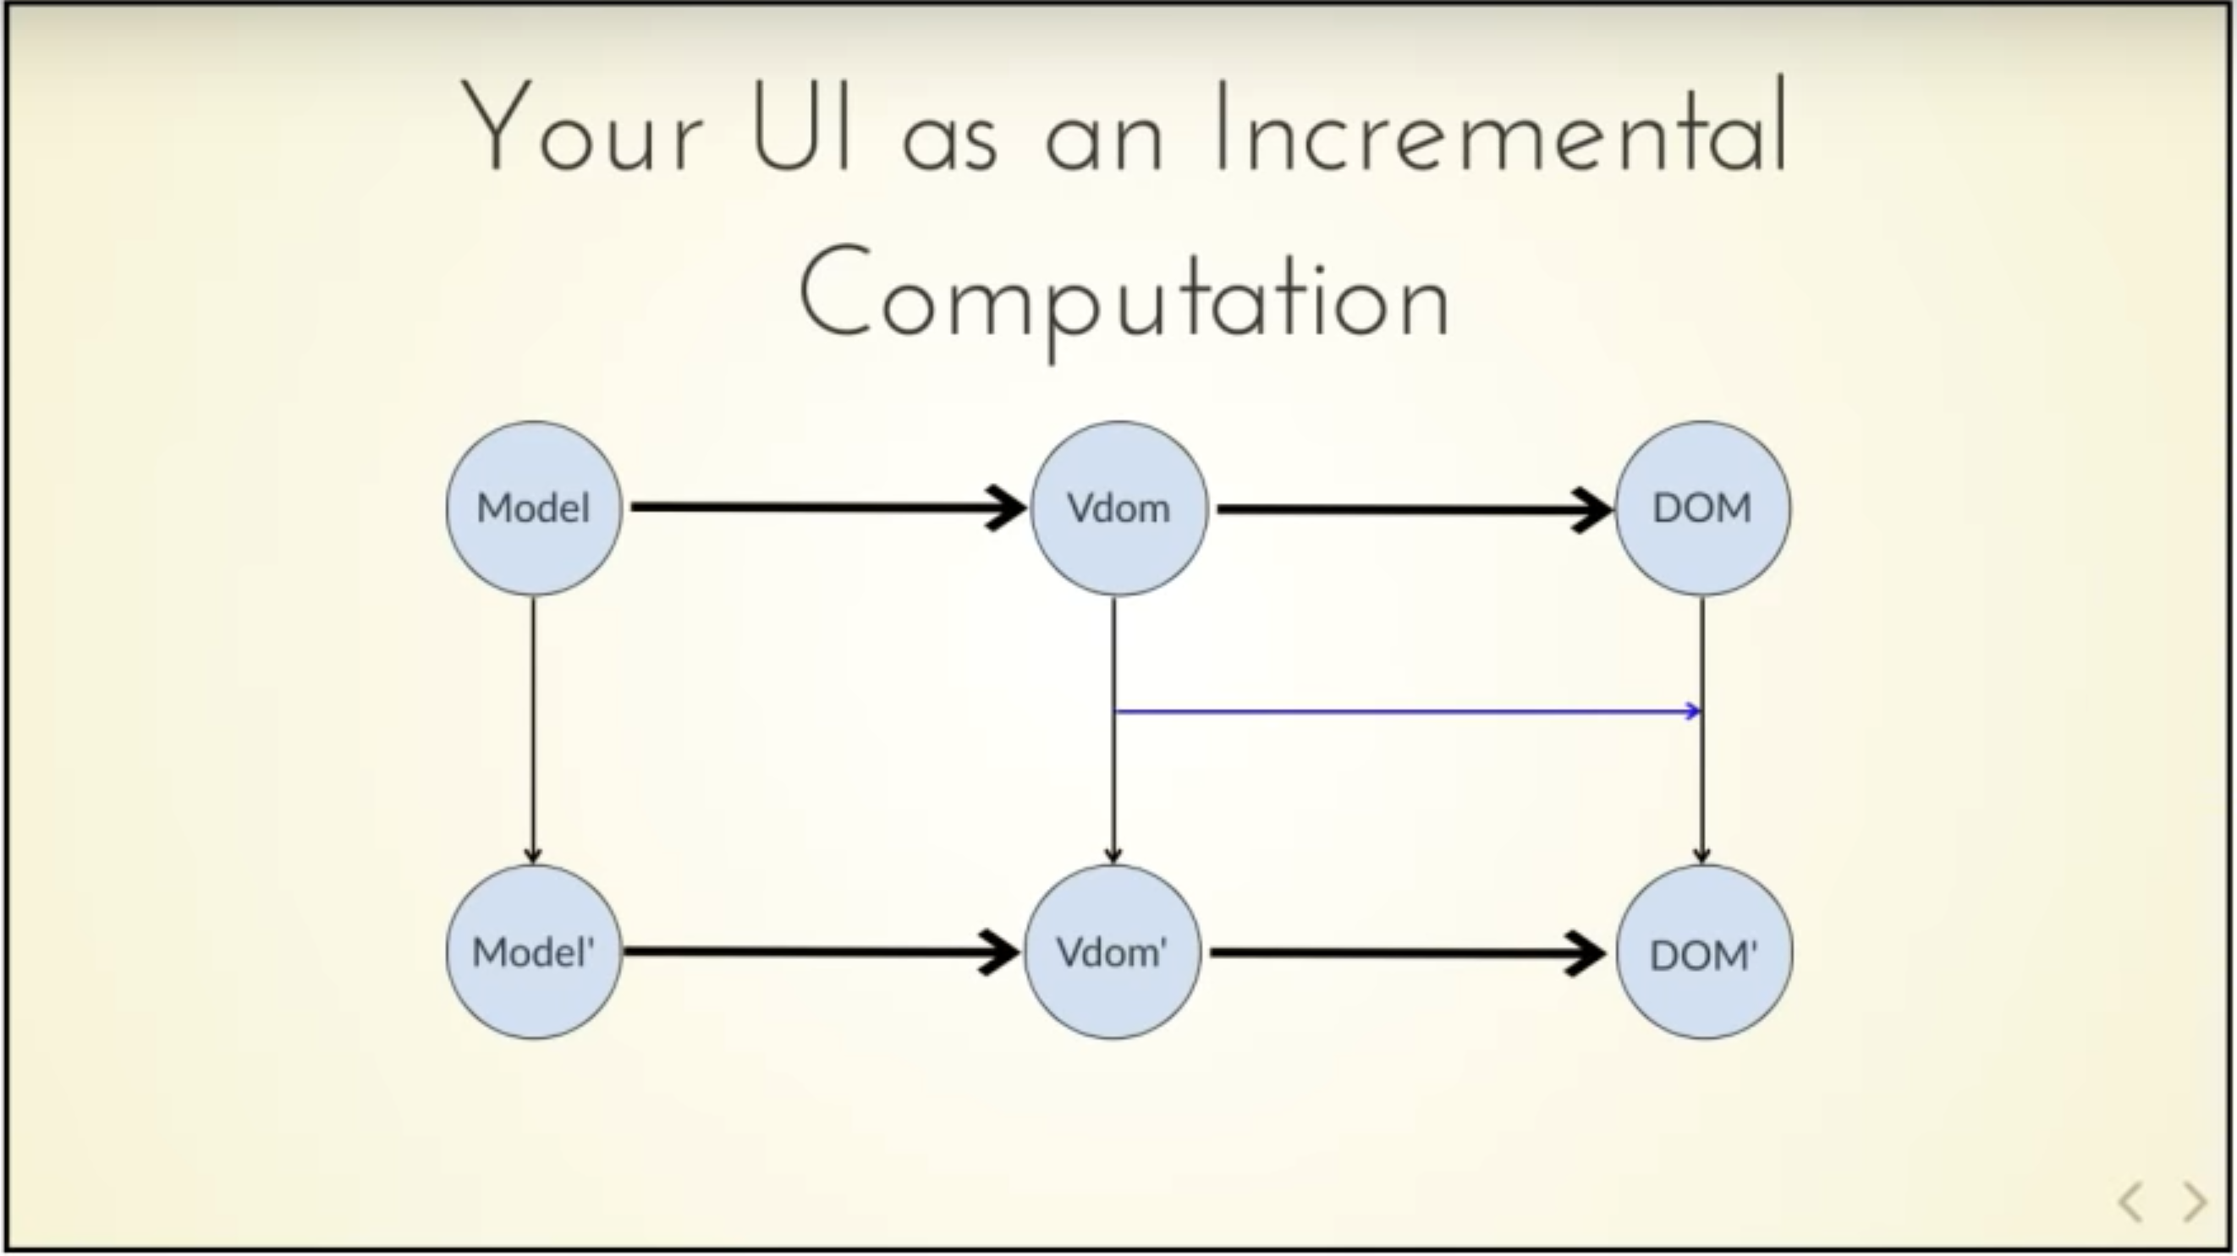
Δ

Slide 24
You recompute the vdom?

Slide 25
You incrementally recompute the vdom?

Slide 26
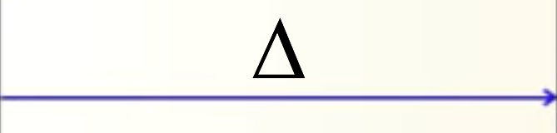
Δ
Δ

Slide 27
MVU
Functional+Diff
Functional
Functional
Elm, Fabulous, Elmish, ….

Slide 28
ΔM ΔV Δ U
Incremental
Functional
Incremental Functional
Incremental
Functional
React

Slide 29
Incremental + Functional? What even is that?

Slide 30
FSharp.Data.Adaptive
github.com/fsprojects/FSharp.Data.Adaptive/

Slide 31
FSharp.Data.Adaptive – Your Data as Incremental Computation
List.map
List. filter
List.sum
Δs
AList.map
Δs
AList.filter
Δs
AList.sum
Δ

Slide 32
Demo
github.com/fsprojects/FSharp.Data.Adaptive/

Slide 33
FSharp.Data.Adaptive – Your Data as Incremental Computation
F# Immutable Data | F# Adaptive Data
int | aval<int>
list<int> | alist<int>
set<int> | aset<int>
map<int, int> | amap<int, int>
[ 1; 2; 3 ] | alist { 1; 2; 3}
1.0 + now.Seconds | aval { let! t = now return t.Seconds + 1.0 }
xs |> List.map (fun x -> x * x) |> List.filter (fun x -> x % 3 = 0) |> List.sum | xs |> AList.map (fun x -> x * x) |> AList.filter (fun x -> x % 3 = 0) |> AList.sum

Slide 34
To the DOM! - The DOM as Data
type DomNode =
{ id: string
attribs: map<string, AttributeValue>
children: DomNode list }

Slide 35
To the DOM! – The DOM as Adaptive Data
type DomNode =
{ id: string
attribs: amap<string, AttributeValue>
children: DomNode alist }
You know have an adaptive DOM
Note this is a recursive adaptive type.
The whole shape of the tree might change and adapt

Slide 36
Adaptive DOM = High performance functional web UI

Slide 37
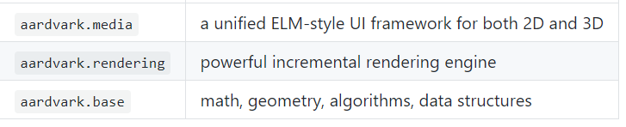
Adaptive scene graphs = High performance functional graphics UI
github.com/aardvark-platform/aardvark.base

Slide 38
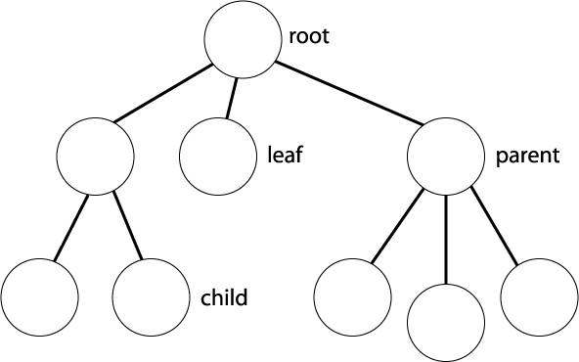
Listening at the edges (in the framework)
The adaptive DOM
The listeners
The actual DOM

Slide 39
Wins of Adaptive Functional Data
Adaptive Data gives very minimal updates
Adaptive Data can have dynamic shape and dependencies
Adaptive Data can have a static outer part for perf
Adaptive Data is computed on-demand, critical for scene graphs

Slide 40
A Simple Adaptive MVU App
type Model =
{ IsPressed: bool }
let update model msg = …
type AdaptiveModel =
{ IsPressed: aval<bool> }
let view (model: AdaptiveModel) dispatch =
aval {
let! pressed = model.IsPressed
if pressed then
View.Label(text="I was pressed!")
else
View.Button(text="Press Me!", command=(fun () -> dispatch Pressed))
}
The functional model
The functional update
This type is automatically synthesised
The adaptive view

Slide 41
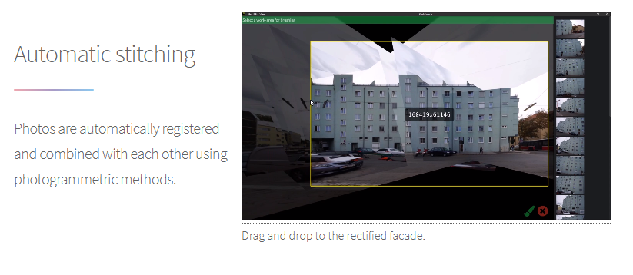


Summary
Adaptive Functional Data makes Functional relevant to amazing high-perf UI

Slide 42
Summary
You can use functional adaptive data in many situations with FSharp.Data.Adaptive

Slide 43
Resources
Talks
Functional Adventures on High Performance Computer Graphics - Georg Haaser
Functional Programming boosting scientific and industrial research – Thomas Ortner
FP vs Efficiency - Harald Steinlechner
Repos
fsprojects.github.io/FSharp.Data.Adaptive/
github.com/aardvark-platform
Resources
VU Design and programming of a rendering engine

